Slide 1
Gradient Descent
Minimizing loss functions to find "optimal" model parameters
Terence Parr
MSDS program University of San Francisco

Slide 2
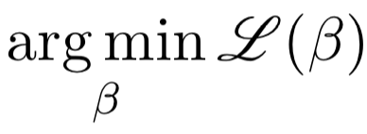
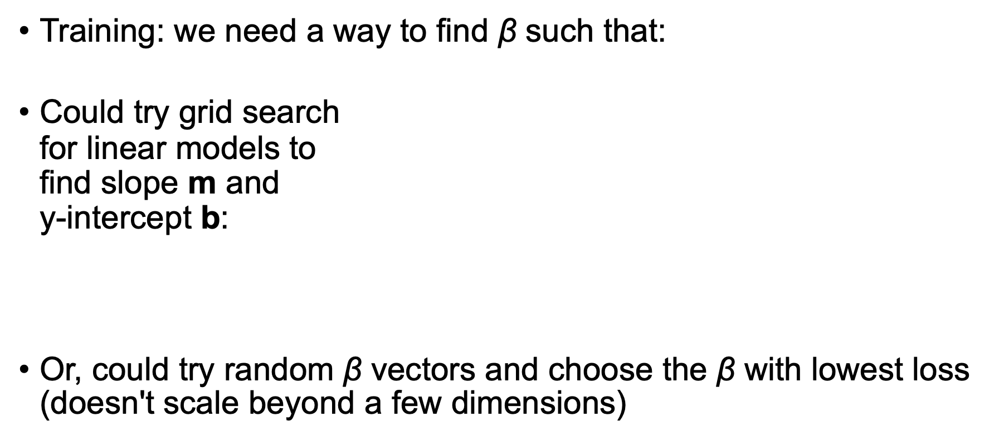
Minimizing the loss function: How we train (many) models
Training: we need a way to find $\text{β}$ such that:
Could try grid search for linear models to find slope m and y-intercept b:
Or, could try random $\text{β}$ vectors and choose the $\text{β}$ with lowest loss (doesn't scale beyond a few dimensions)
best = (9999999999,0,0)
for m in np.linspace(…,…,num=100):
for b in np.linspace(…,…,num=100):
y_ = m * X + b
loss = np.mean((y_ - y)**2) # MSE
if loss < best[0]:
best = (loss,m,b)

Slide 3
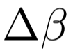
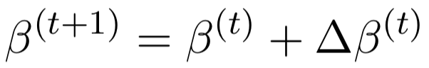
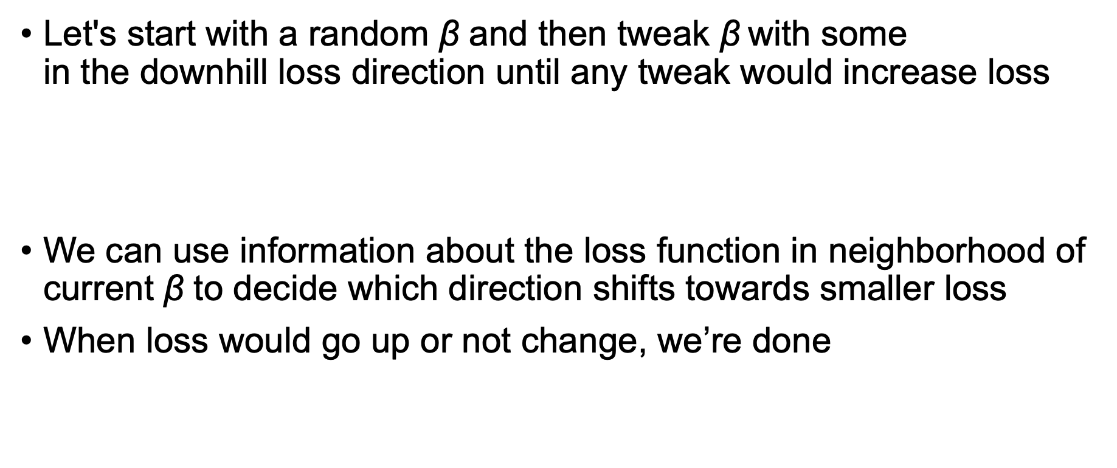
Minimizing the loss: using loss information
Let's start with a random $\text{β}$ and then tweak $\text{β}$with some in the downhill loss direction until any tweak would increase loss
We can use information about the loss function in neighborhood of current $\text{β}$ to decide which direction shifts towards smaller loss
When loss would go up or not change, we’re done

Slide 4
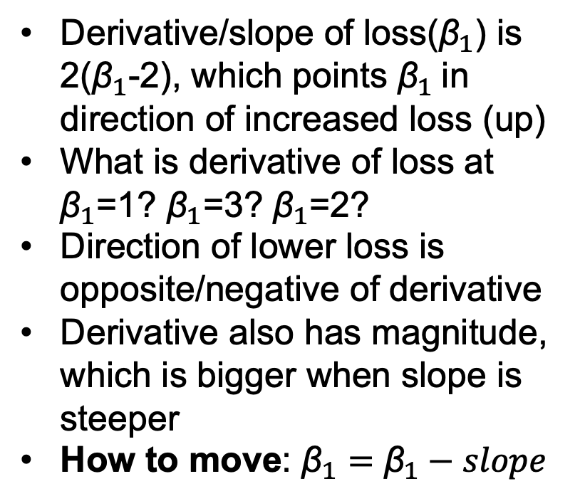
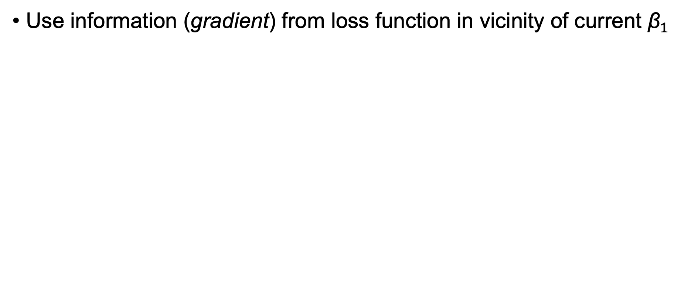
How do we pick a direction to move (1D)?
Use information (gradient) from loss function in vicinity of current ${\text{β}}_{1}$
Derivative/slope of loss(${\text{β}}_{1}$) is 2(${\text{β}}_{1}$-2), which points ${\text{β}}_{1}$in direction of increased loss (up)
What is derivative of loss at ${\text{β}}_{1}$=1? ${\text{β}}_{1}$=3? ${\text{β}}_{1}$=2?
Direction of lower loss is opposite/negative of derivative
Derivative also has magnitude, which is bigger when slope is steeper
How to move: ${\text{β}}_{1}={\text{β}}_{1}−slope$

Slide 5
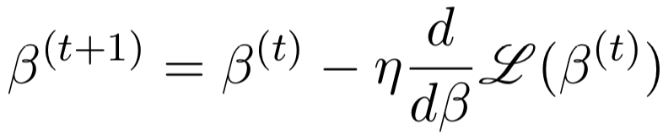
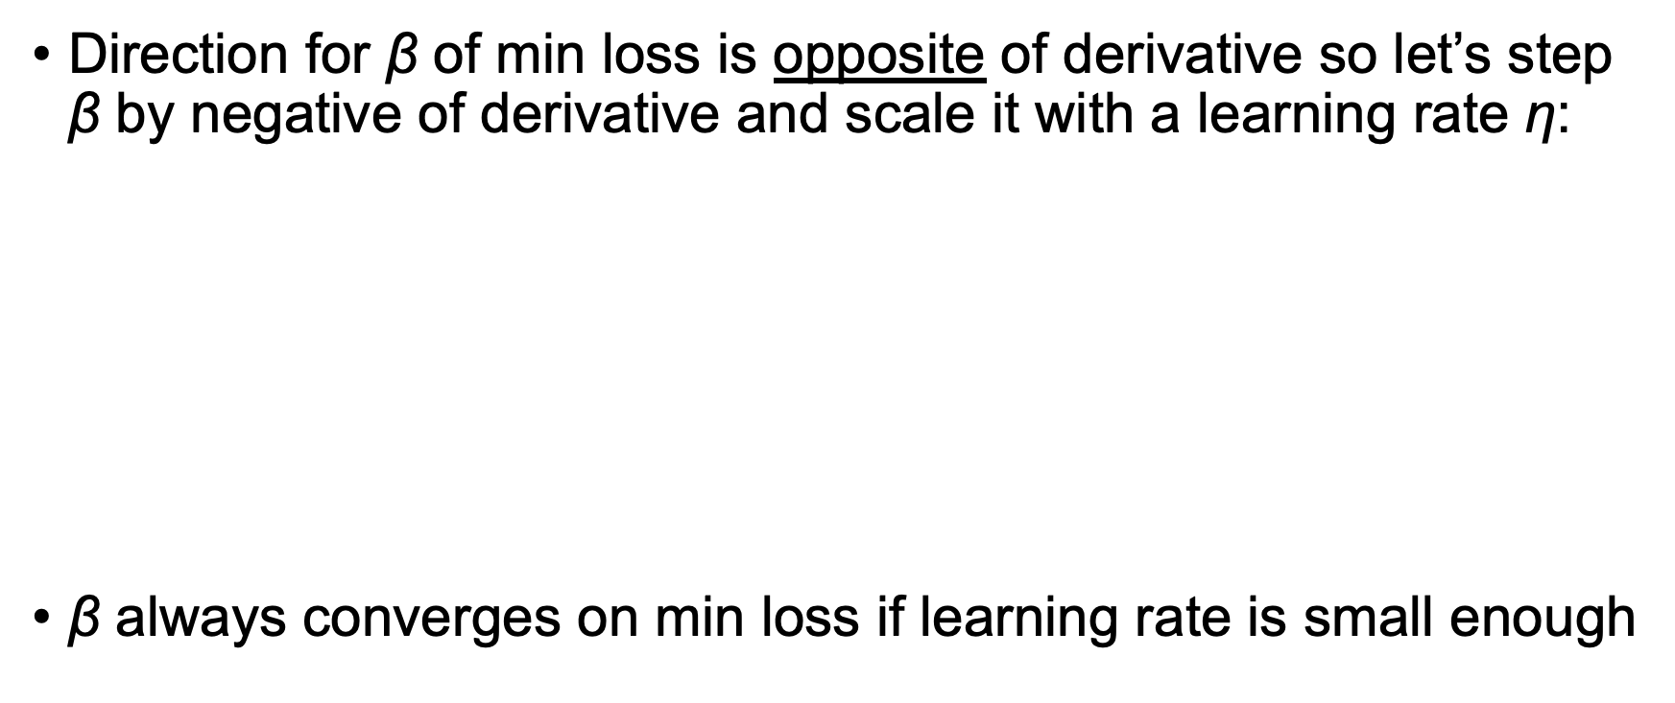
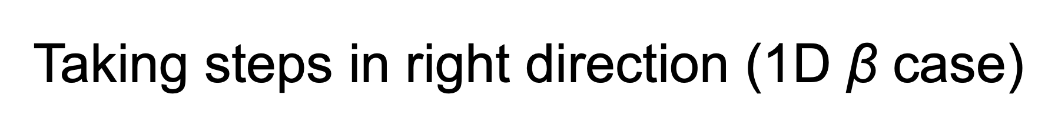
Taking steps in right direction (1D $\text{β}$ case)
Direction for $\text{β}$ of min loss is opposite of derivative so let’s step $\text{β}$ by negative of derivative and scale it with a learning rate η:
$\text{β}$ always converges on min loss if learning rate is small enough
b = random value
while not_converged:
b = b - rate * gradient(b)

Slide 6
Python gradient descent implementation
First define a simple loss function and its gradient:
Then, pick a random starting point and pick a learning rate
Loop for a while or until L2 norm of gradient(b) == 0
def f(b) : return (b-2)**2
def gradient(b): return 2*(b-2)
b = np.random.uniform(0,4)
rate = .2
for t in range(10): # for awhile
b = b - rate * gradient(b)
See https://github.com/parrt/msds621/blob/master/notebooks/linear-models/viz-gradient-descent.ipynb

Slide 7
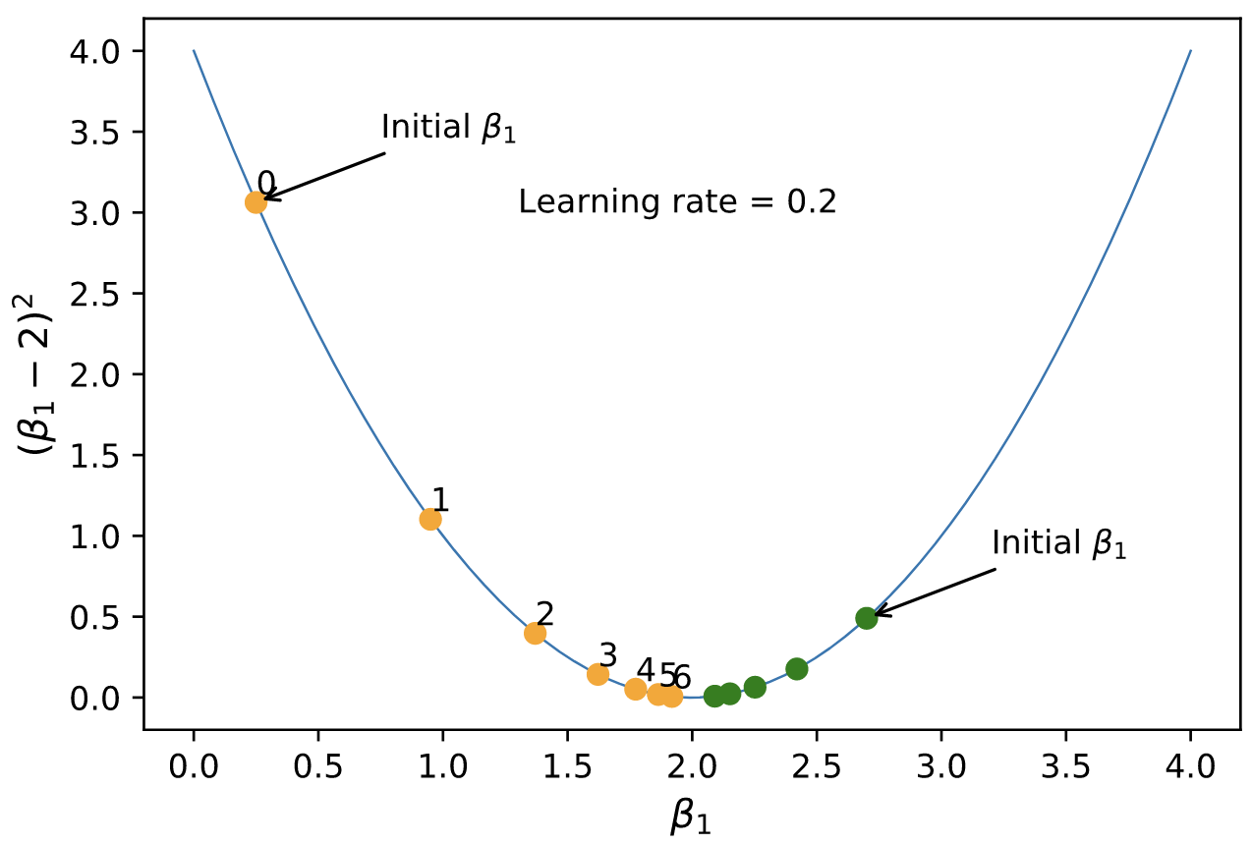
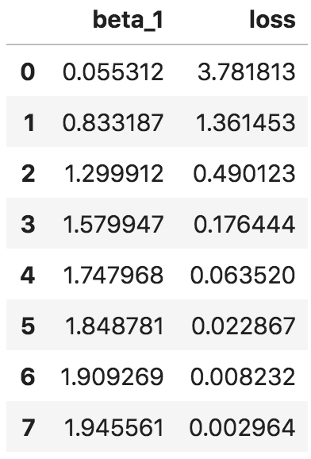
Sample 1D gradient descent run
for t in range(7):
b = b – 0.2 * gradient(b)
Notice ${\text{β}}_{1}$ accelerates and then slows down. Why?
See https://github.com/parrt/msds621/blob/master/notebooks/linear-models/viz-gradient-descent.ipynb

Slide 8
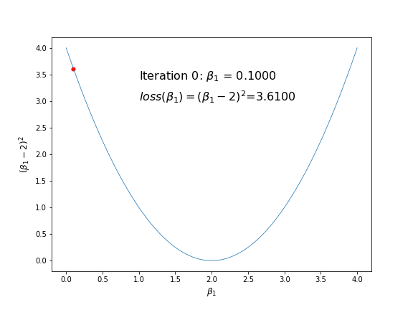
1D function minimization in action
See https://github.com/parrt/msds621/blob/master/notebooks/linear-models/viz-gradient-descent.ipynb

Slide 9
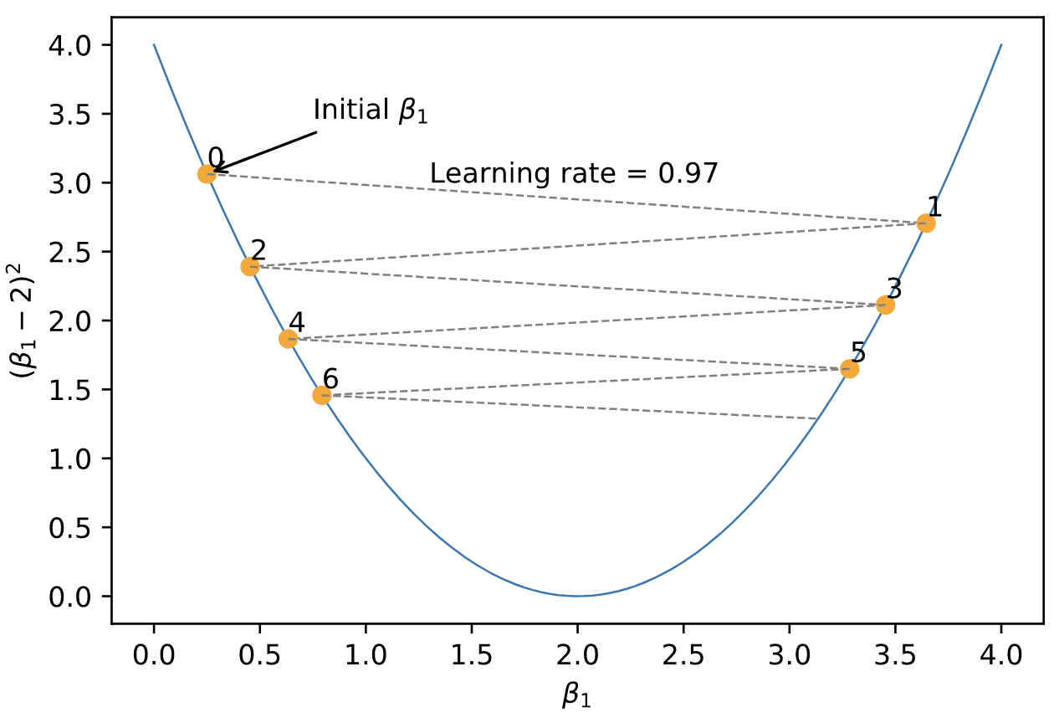
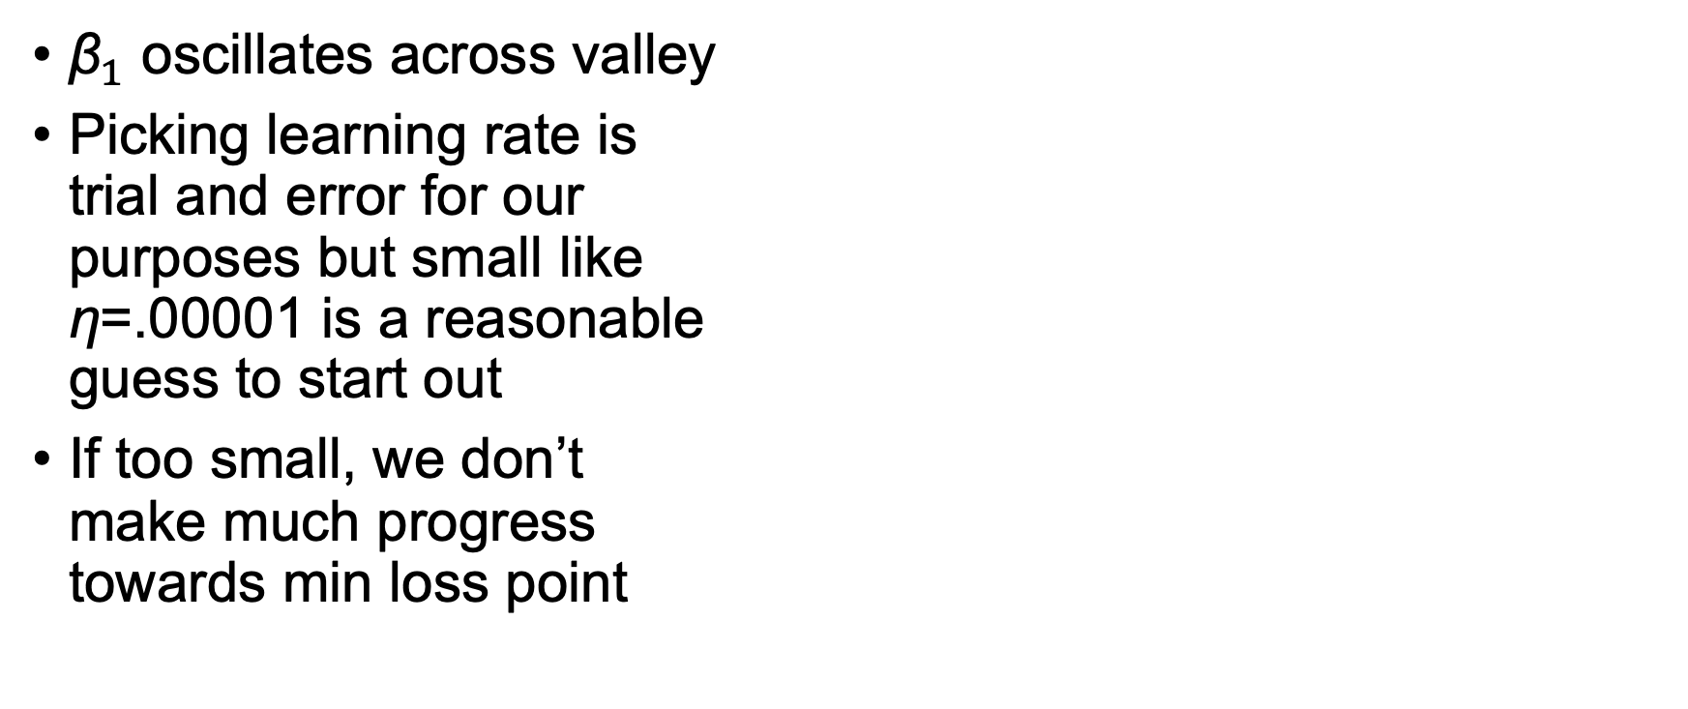
What if we crank up learning rate?
${\text{β}}_{1}$ oscillates across valley
Picking learning rate is trial and error for our purposes but small like η=.00001 is a reasonable guess to start out
If too small, we don’t make much progress towards min loss point

Slide 10
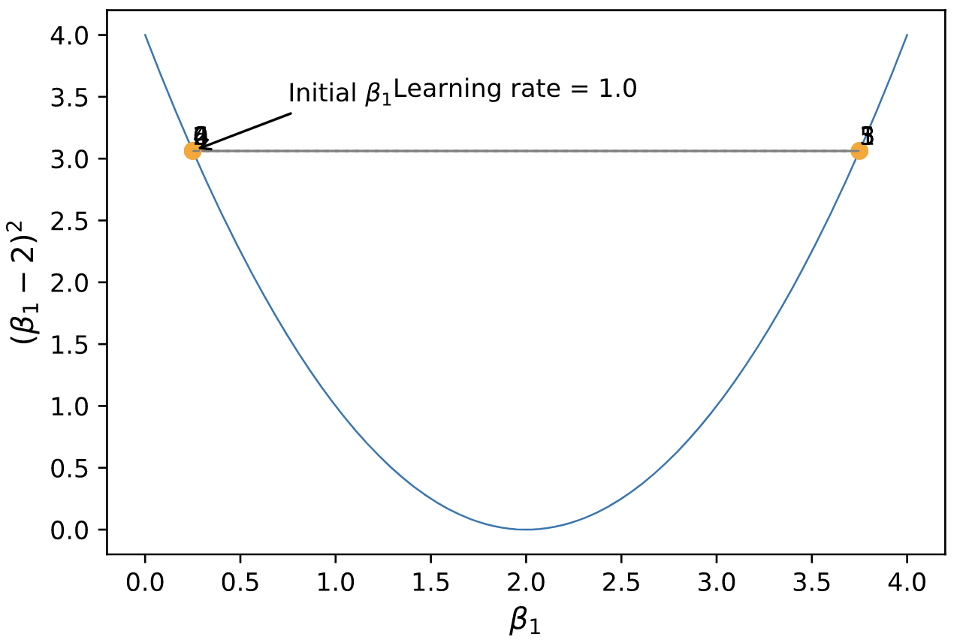
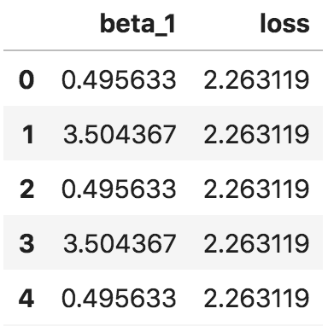
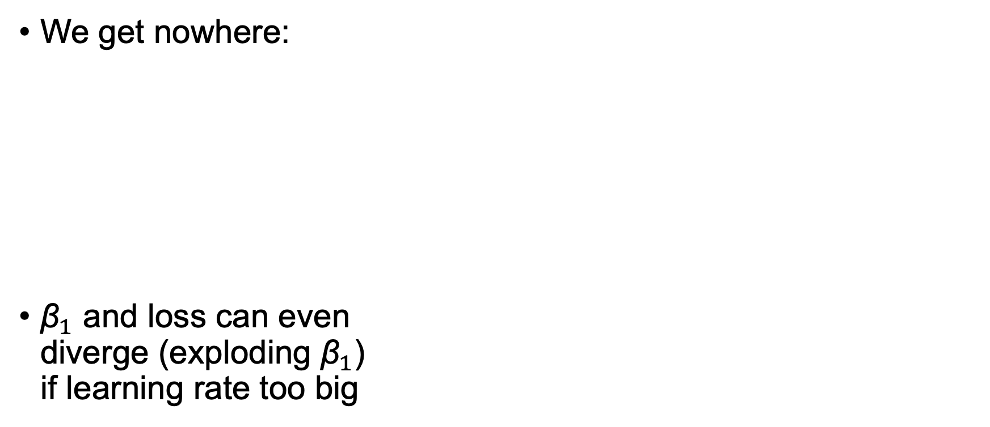
What if learning rate is really too high?
We get nowhere:
${\text{β}}_{1}$ and loss can even diverge (exploding ${\text{β}}_{1}$) if learning rate too big

Slide 11

What happens in 2D for $\text{β}$= [${\text{β}}_{1}$, ${\text{β}}_{2}$]?
Imagine you’re stuck on a mountain in the dark and need to get to the bottom
Take steps to left, right, forward, backward or at an angle to minimize the “elevation function”
Check slope in each direction separately, then combine them into vector to obtain the best step direction
Each direction’s slope is a partial derivative and, combined, are called the gradient vector

Slide 12
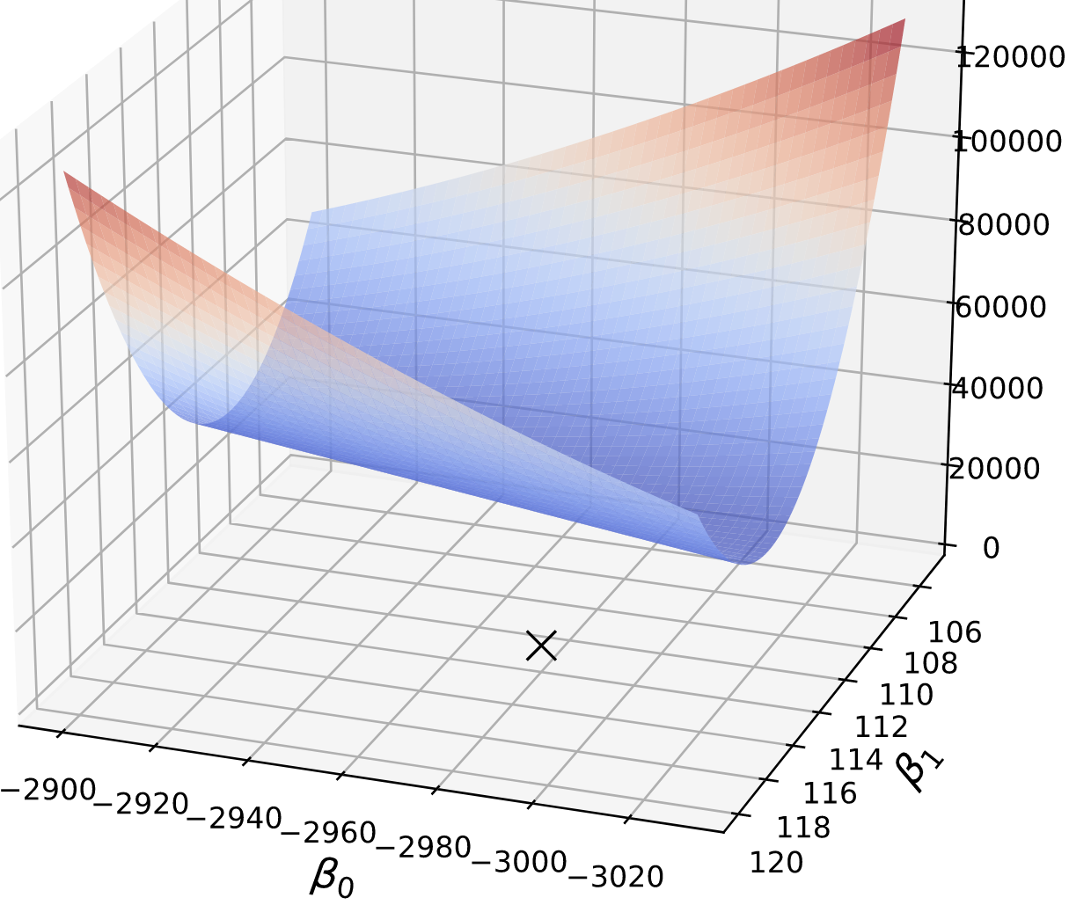
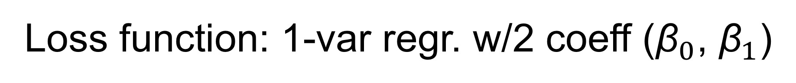
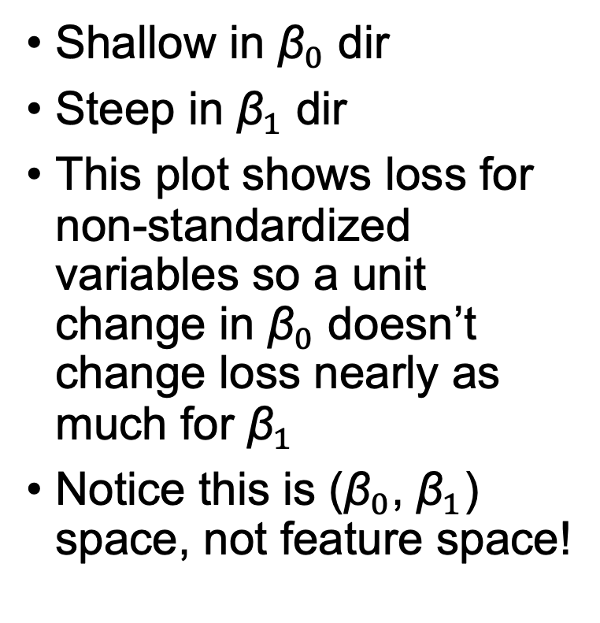
Loss function: 1-var regr. w/2 coeff (${\text{β}}_{0}$, ${\text{β}}_{1}$)
Shallow in ${\text{β}}_{0}$ dir
Steep in ${\text{β}}_{1}$ dir
This plot shows loss for non-standardized variables so a unit change in ${\text{β}}_{0}$ doesn’t change loss nearly as much for ${\text{β}}_{1}$
Notice this is (${\text{β}}_{0}$, ${\text{β}}_{1}$) space, not feature space!

Slide 13
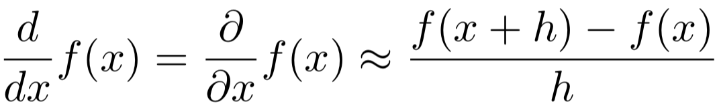
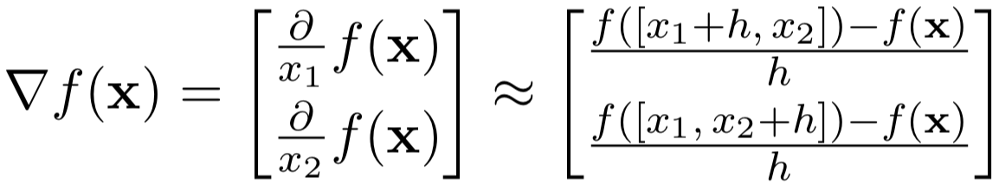
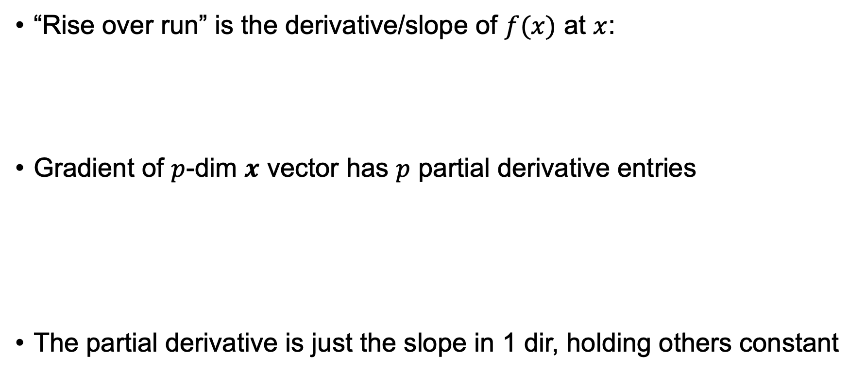
Notation and finite difference approximation
“Rise over run” is the derivative/slope of $f(x)$ at $x$:
Gradient of $p$-dim $x$ vector has $p$ partial derivative entries
The partial derivative is just the slope in 1 dir, holding others constant
See https://explained.ai/matrix-calculus/index.html

Slide 14
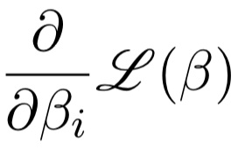
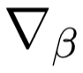
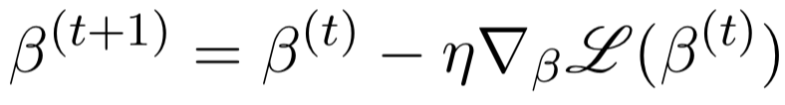
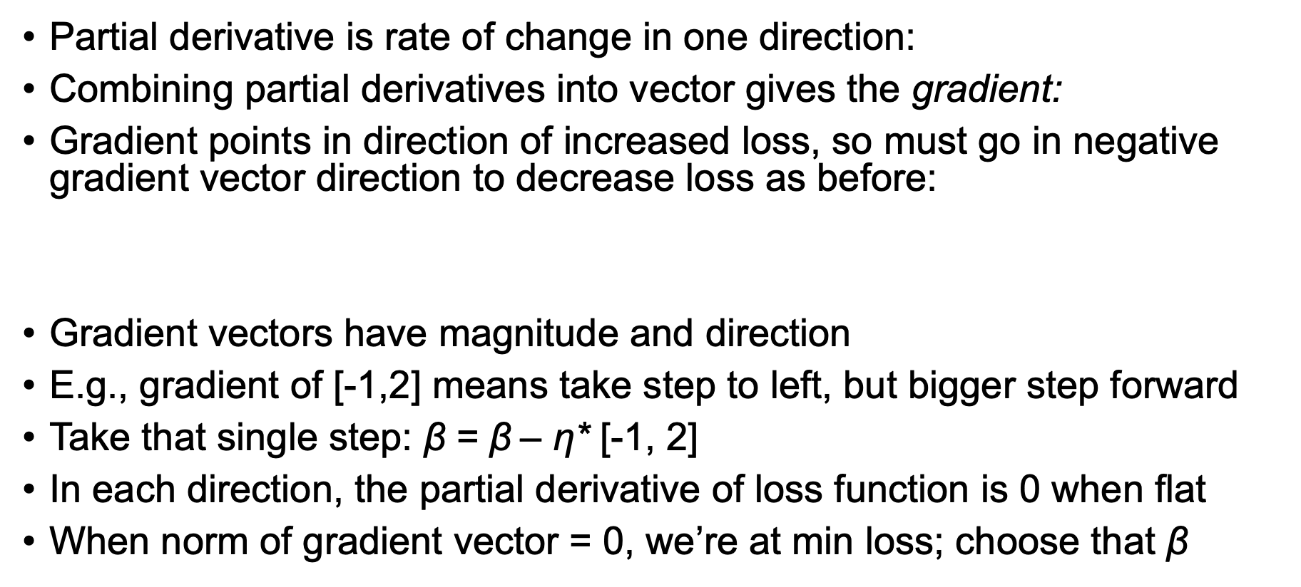
General gradient descent
Partial derivative is rate of change in one direction:
Combining partial derivatives into vector gives the gradient:
Gradient points in direction of increased loss, so must go in negative gradient vector direction to decrease loss as before:
Gradient vectors have magnitude and direction
E.g., gradient of [-1,2] means take step to left, but bigger step forward
Take that single step: $\text{β}$ = $\text{β}$– η* [-1, 2]
In each direction, the partial derivative of loss function is 0 when flat
When norm of gradient vector = 0, we’re at min loss; choose that $\text{β}$
where η is a learning rate

Slide 15
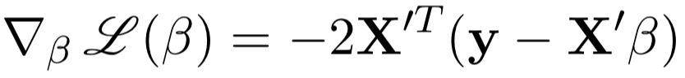
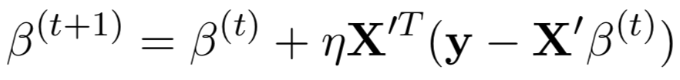
Update equation needs loss gradient:
Gradient of
for regression is
So update equation becomes (adding learning rate η):
η scales the step we take each at each step (fold 2 into η)

Slide 16
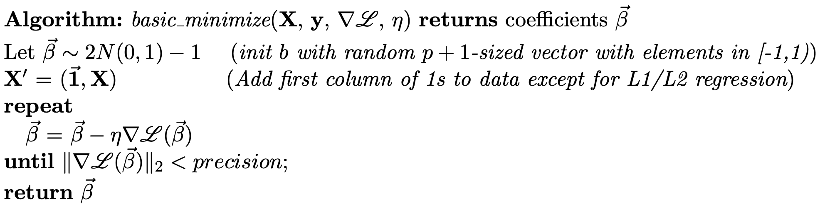
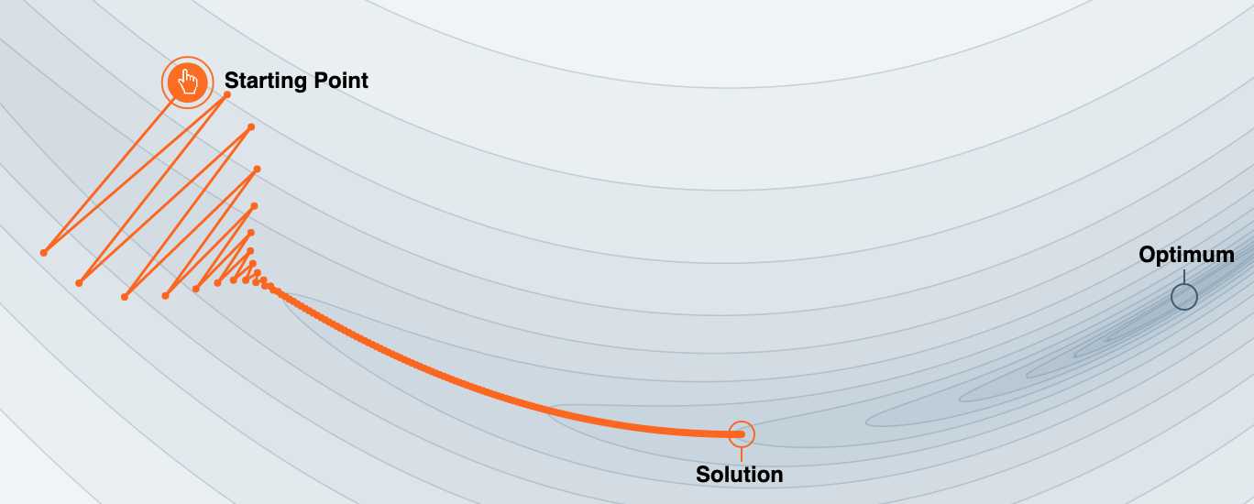
Simplest gradient descent algorithm
new direction
(Recall
)
Image credit https://distill.pub/2017/momentum

Slide 17
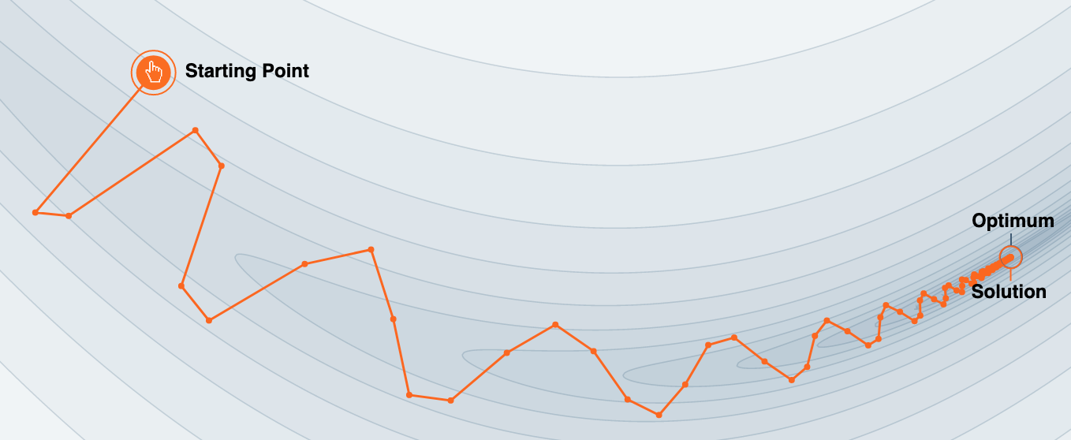
Let's add momentum
No momentum
Reinforce movement in same direction
High momentum
Image credit https://distill.pub/2017/momentum

Slide 18
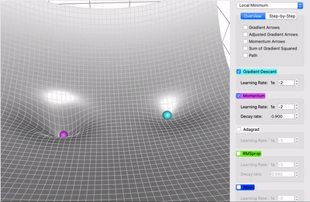
Vanilla vs momentum animated
Animation credit: https://towardsdatascience.com/a-visual-explanation-of-gradient-descent-methods-momentum-adagrad-rmsprop-adam-f898b102325c
Momentum rolls through a local miminum, but vanilla gets stuck

Slide 19
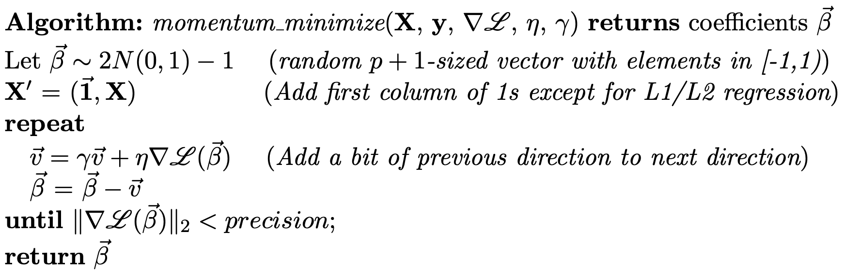
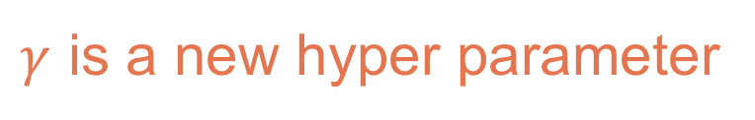
Adding momentum to particle update
Reinforce movement in same direction: add fraction of previous dir
old direction
new direction
$γ$ is a new hyper parameter

Slide 20
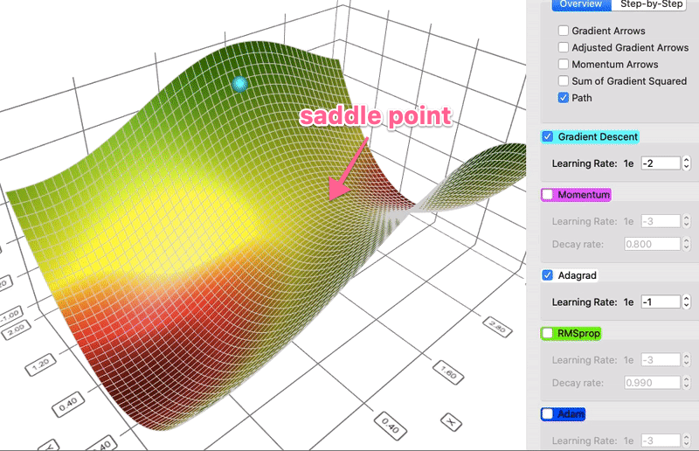
Dealing with saddle points or shallow valleys: Vanilla vs AdaGrad animated
Animation credit: https://towardsdatascience.com/a-visual-explanation-of-gradient-descent-methods-momentum-adagrad-rmsprop-adam-f898b102325c
Different step size per dimension helps a lot
We still can use an overall learning rate to magnify the step size per dimension

Slide 21
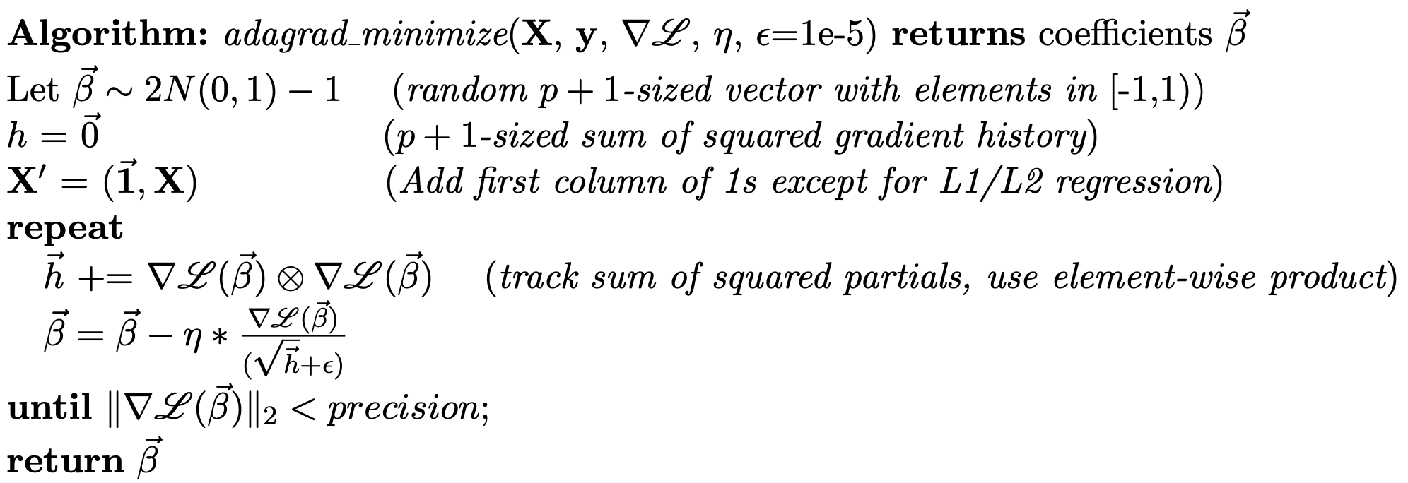
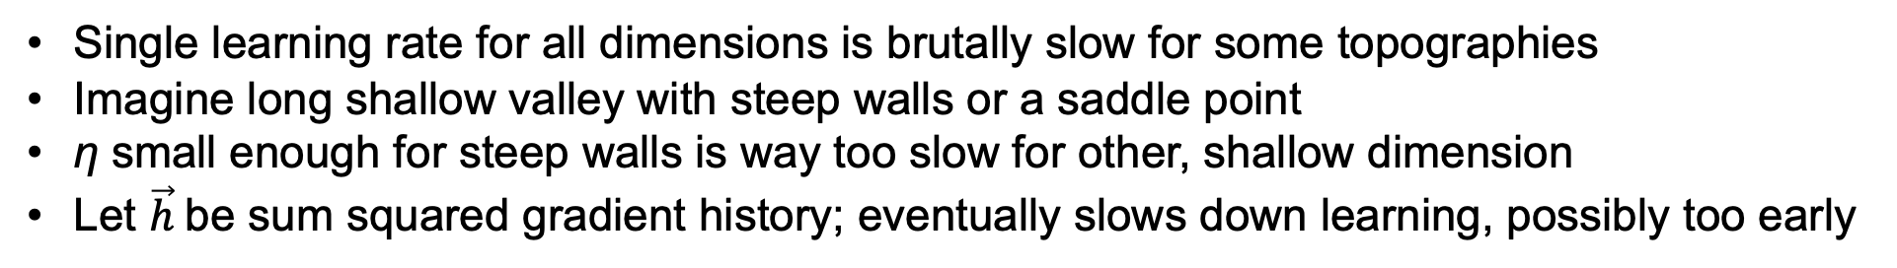
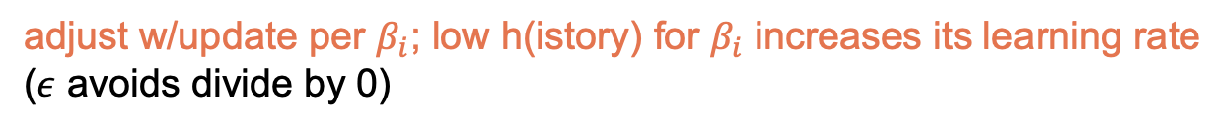
Adagrad gradient descent
Single learning rate for all dimensions is brutally slow for some topographies
Imagine long shallow valley with steep walls or a saddle point
η small enough for steep walls is way too slow for other, shallow dimension
Let $\vec{h}$be sum squared gradient history; eventually slows down learning, possibly too early
adjust w/update per $β_{i}$; low h(istory) for $β_{i}$ increases its learning rate
($ε$ avoids divide by 0)
See http://cs231n.github.io/neural-networks-3/#ada

Slide 22
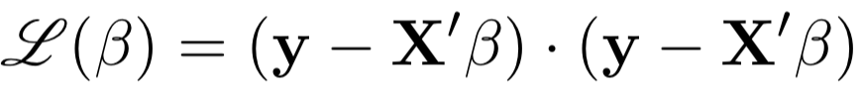
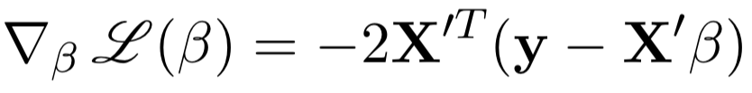
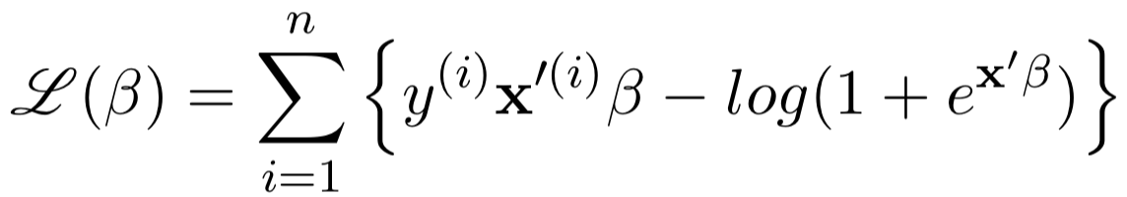
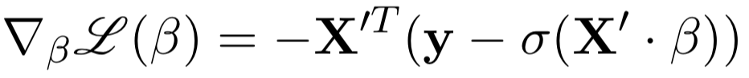
Loss, gradient functions for minimization
Linear regression
Logistic regression
(Can drop the 2, folding into learning rate)

Slide 23
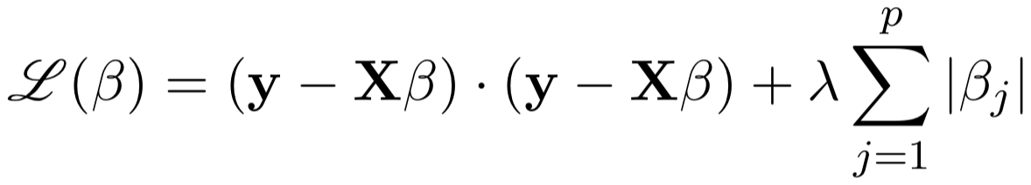
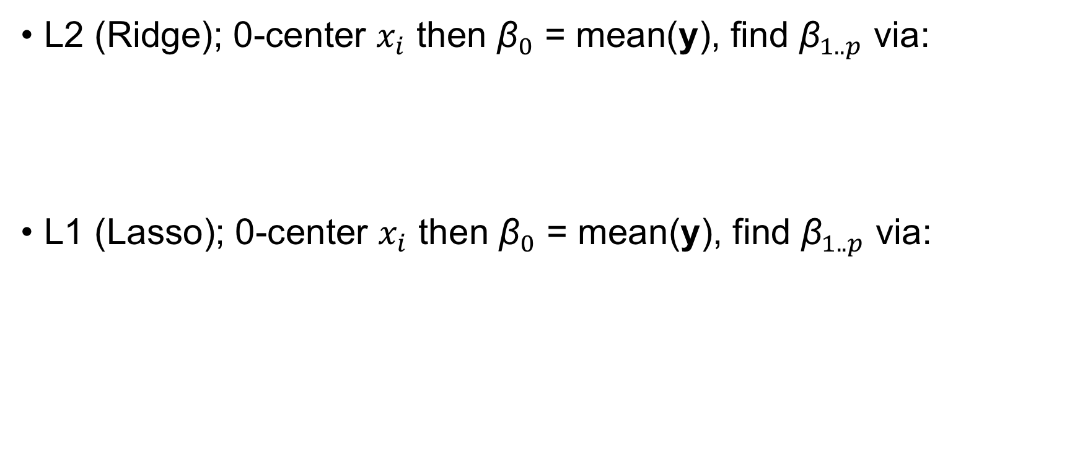
L1, L2 regression loss, gradient functions
L2 (Ridge); 0-center $x_{i}$ then ${\text{β}}_{0}$ = mean(y), find ${\text{β}}_{1..p}$ via:
L1 (Lasso); 0-center $x_{i}$ then ${\text{β}}_{0}$ = mean(y), find ${\text{β}}_{1..p}$ via:
(Can drop the 2, folding into learning rate)

Slide 24
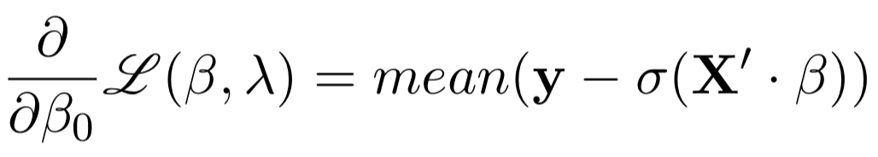
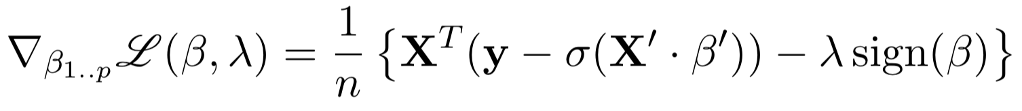
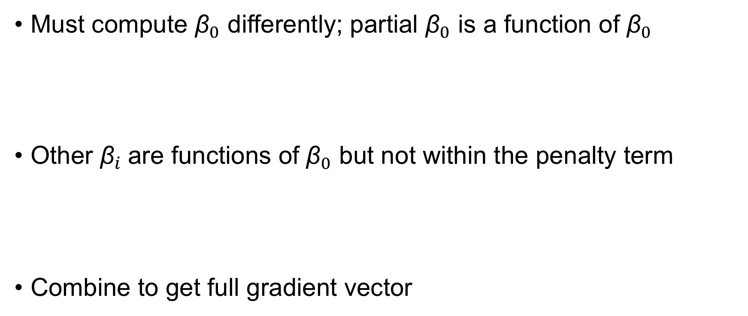
L1 logistic loss, gradient functions
Must compute ${\text{β}}_{0}$ differently; partial ${\text{β}}_{0}$ is a function of ${\text{β}}_{0}$
Other ${\text{β}}_{i}$are functions of ${\text{β}}_{0}$ but not within the penalty term
Combine to get full gradient vector

Slide 25
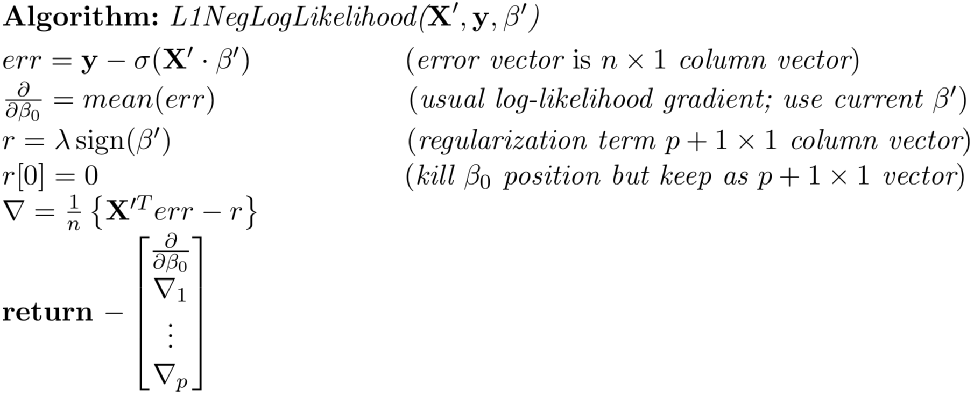


L1 Logistic gradient is tricky to get right
(See derivation of L1 gradients in appendix of project description)
gradients

Slide 26


Key takeaways
Move $β$ towards lower loss; consider each $β_{i}$direction separately
Slope (change in loss/${\text{β}}_{i})$ in direction ${\text{β}}_{i}$ is partial derivative:
Gradient is p or p+1 dimensional vector of partial derivatives
Gradients point “upwards” towards higher cost/loss
Coefficients $β$ should therefore step by negative of gradient
Gradient is the 0 vector at the minimum loss; i.e., flat
Can stop optimizing when gradient norm is close to 0 or after fixed number of iterations

Slide 27


More key takeaways
Coefficient update equation:
If η is “small enough,” ${\text{β}}_{}^{(t+1)}$ will converge to a solution vector (maybe slowly)
If too big, will bounce back and forth across valleys or diverge
Adagrad
Single learning rate too slow; need a rate per dimension
Increases update step size for dimensions with shallow slopes historically
Slows down across all dimensions over time as history sum $h$ gets bigger
L1, L2 linear regression doesn’t optimize ${\text{β}}_{0}$, it’s just mean(y), if we 0-center $x_{i}$
L1, L2 logistic regression optimizes ${\text{β}}_{0..p}$ but optimizes ${\text{β}}_{0}$ differently than ${\text{β}}_{1..p}$
where η is a learning rate

Slide 28
Lab time
Exploring regularization for linear regression https://github.com/parrt/msds621/tree/master/labs/linear-models/gradient-descent.ipynb

